Slide 1

Newspaper Systems
High-Level Workflow
Confidential

Slide 2
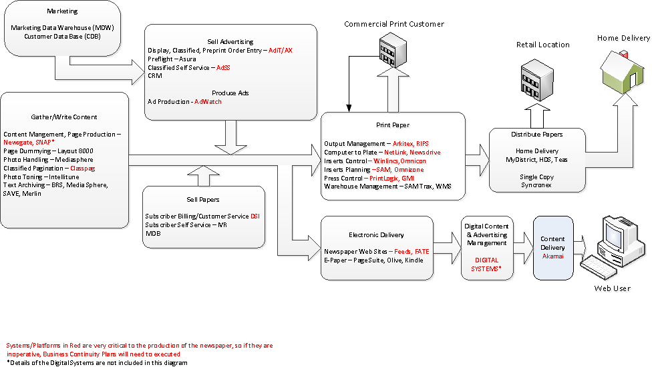
Newspaper Systems High-Level Workflow

Slide 3
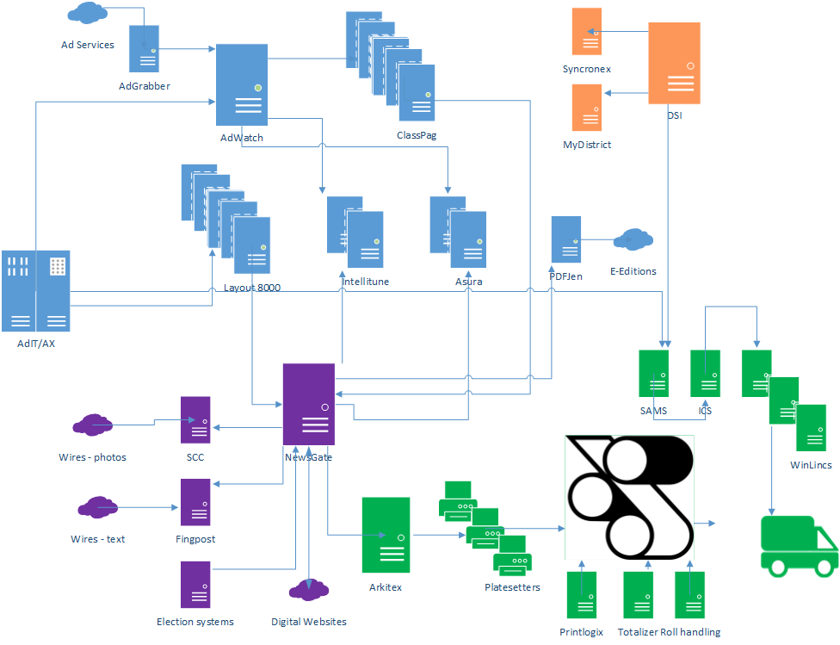
How the Newspaper Comes Together
Advertising
Editorial
Circulation
Operations

Slide 4
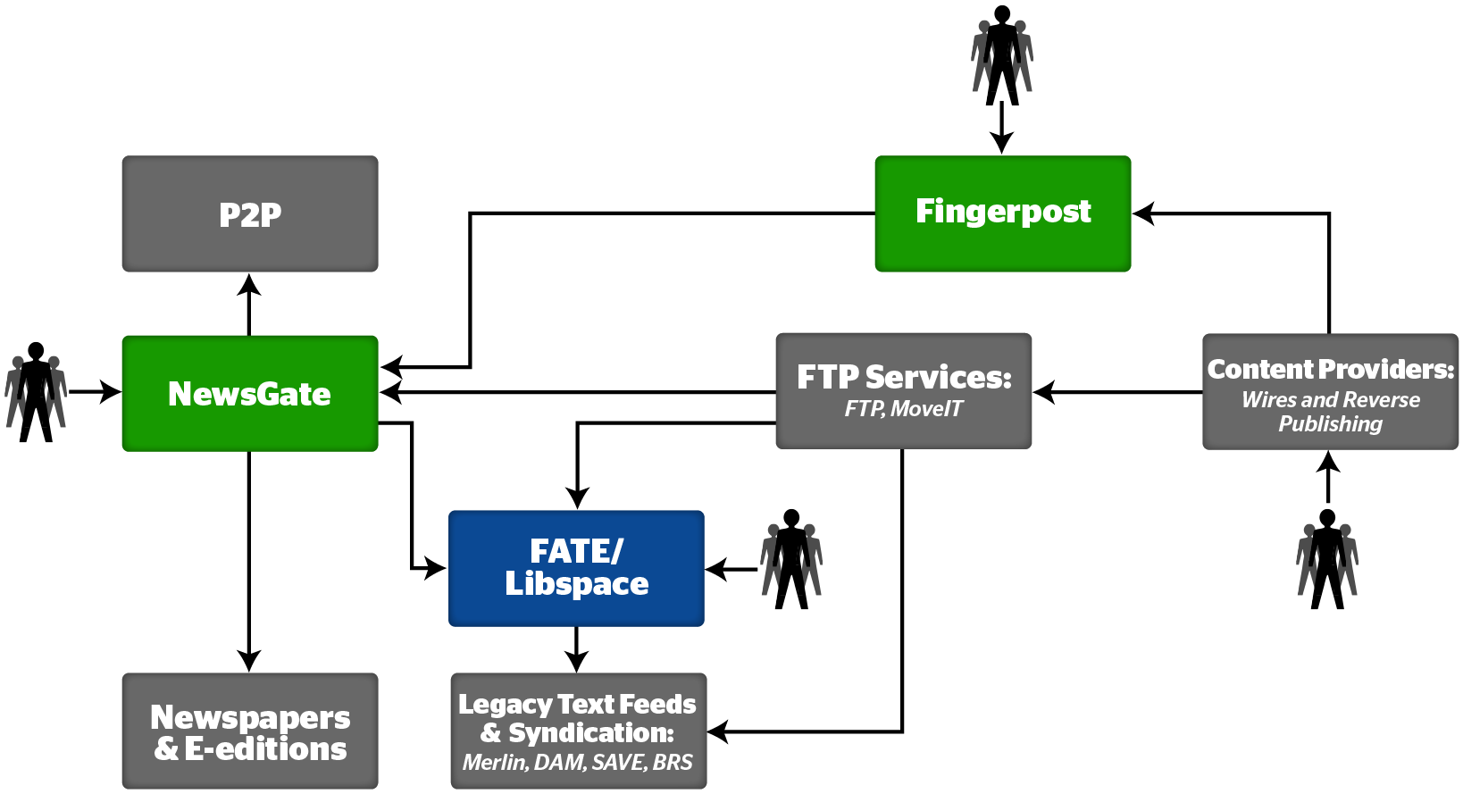
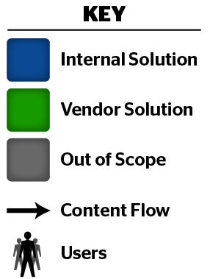
Editorial Systems Overview
SNAP
NewsGate
Print/online content generation and pagination system. Feeds content to output systems and the P2P online CMS.
Feeds and Transformation Engine (FATE)/Libspace
Receives, formats, transmits text and image files to archive systems, e-readers, and syndication partners.
Fingerpost (FIP)
Fetches, receives, formats, transmits wire text files. Hosts wire browser. Integrates with NewsGate, wire providers.
Notes:
Oracle: Digital Content Database
Content Services & Device Services: Services powering Device Agnostic
P2P: Content Management System
Turbine: core system that renders websites
Hopper: system for moving content from editorial to online
FAST Search Engine

Slide 5
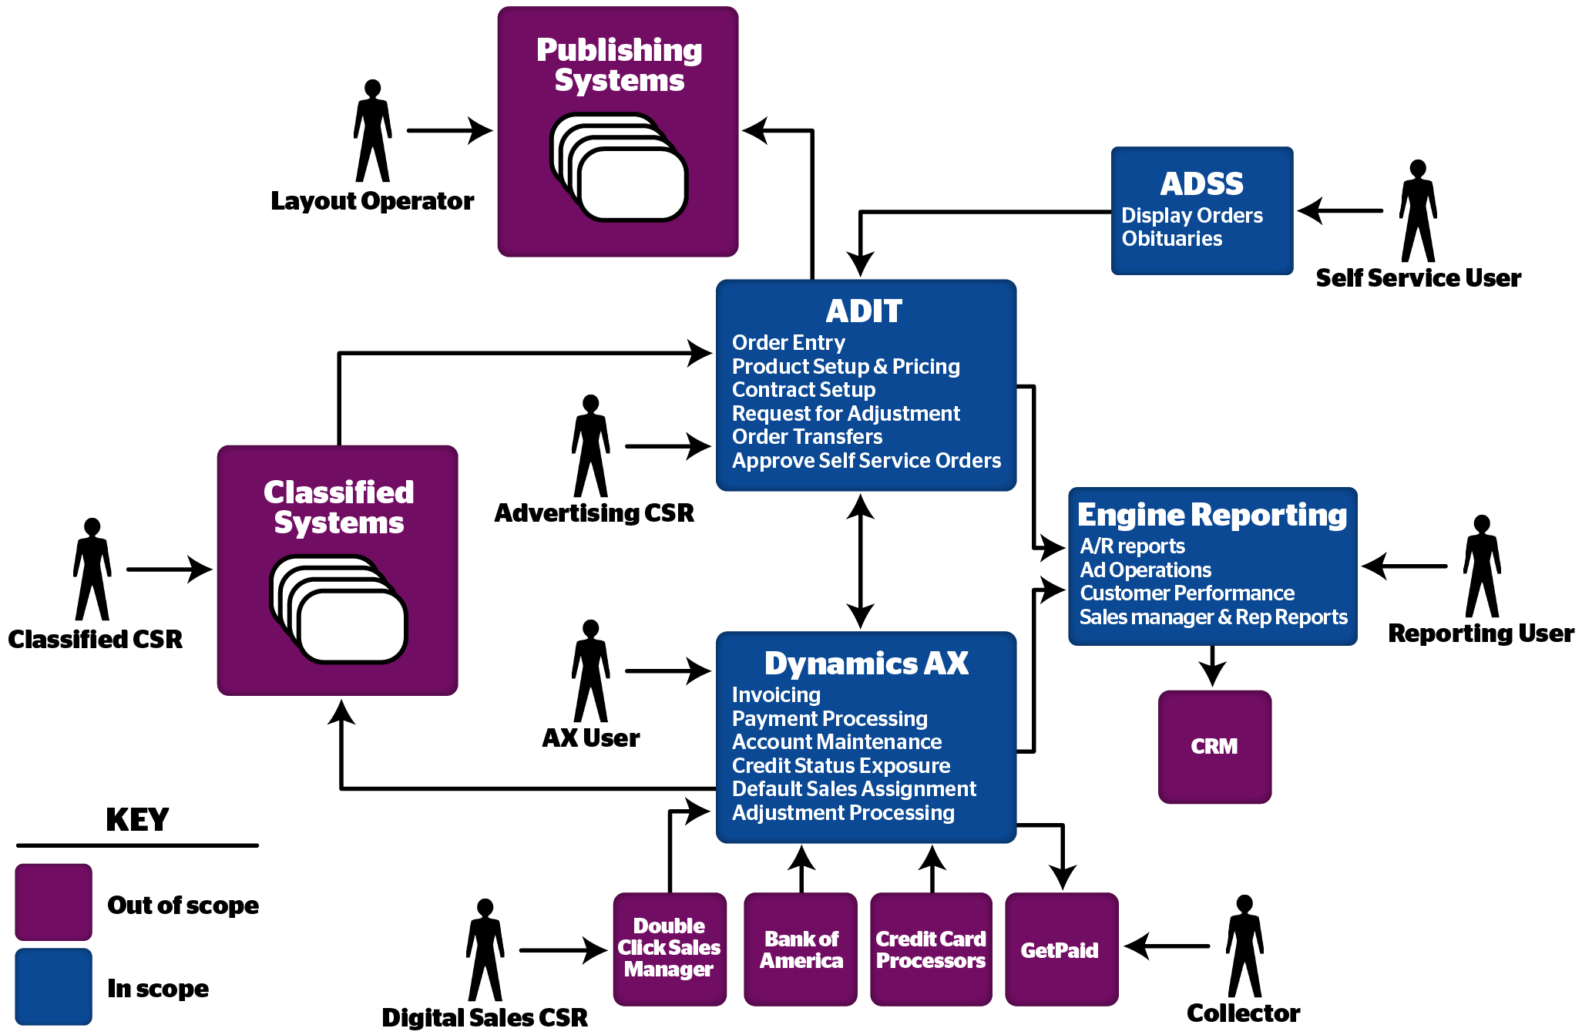
Ad Order Entry/Billing Systems Overview-Engine
Notes:
Oracle: Digital Content Database
Content Services & Device Services: Services powering Device Agnostic
P2P: Content Management System
Turbine: core system that renders websites
Hopper: system for moving content from editorial to online
FAST Search Engine

Slide 6
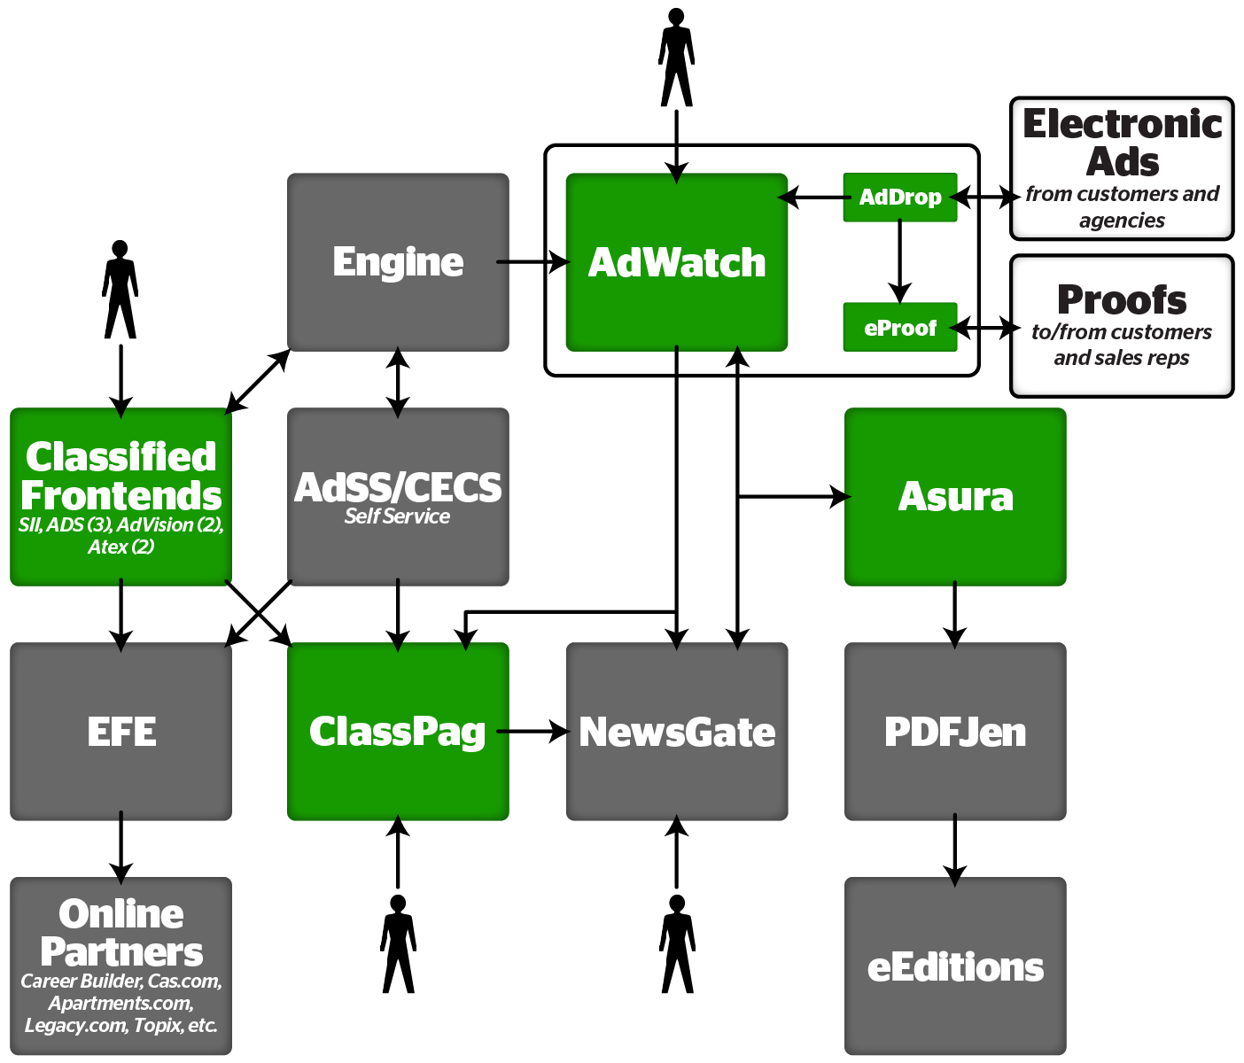
Advertising Systems Overview
AdWatch Tribune standard display ad building system. Manages workflow.
Asura Postscript pre-flight software. Ensures successful deadline delivery. Optimizes postscript by eliminating content outside bounding box, color correction, streamlining fonts, handling transparencies.
ClassPag
Flows liner ads around the corresponding display ads for each classification. Places page furniture such as page headers and banners. Square-offs (partial page classified listings), sent to NewsGate for output. Full page output directly.

Slide 7
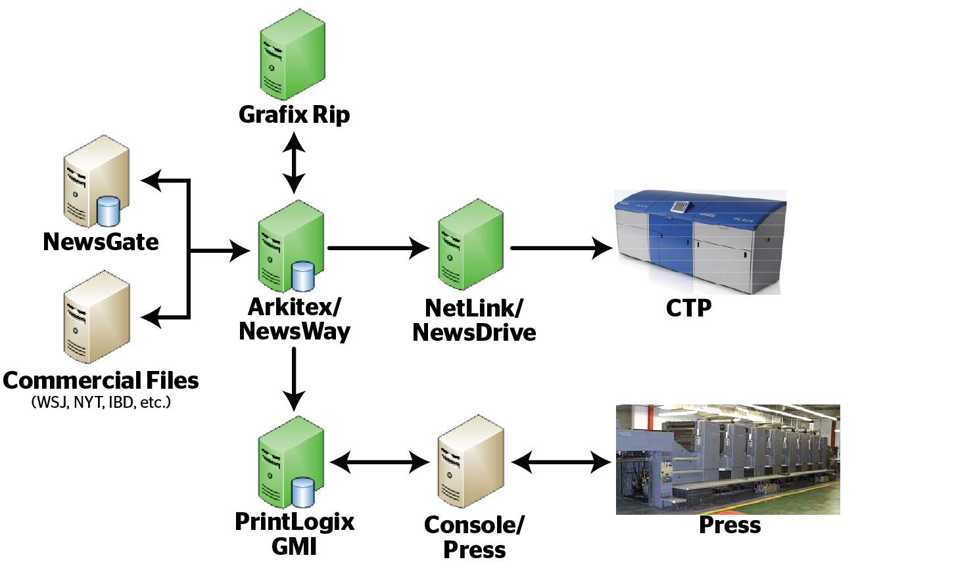

Print Operations Flow
ARKITEX/NEWSWAY: Applications that manage and track all output related processes; routes print files to specific rips and sends files to CTP devices via NetLink/NewsDrive. GRAFIX RIP: Converts Postscript and PDF files to G4 compressed Tiff files; conversion is needed for CTP devices to perform imaging process.
NETLINK/NEWSDRIVE: Applications that act as gateway and buffer between Arkitex and CTP devices; they manage the workflow to CTP devices.
PRINTLOGIX-GMI (PRESS CONTROL): Applications that provide the operation and functionality necessary to control all press related operations, tracks Totalized print pages. (Imposisitions are laid-out for specific press units, job description and press runs are defined and assigned to press, etc.).

Slide 8
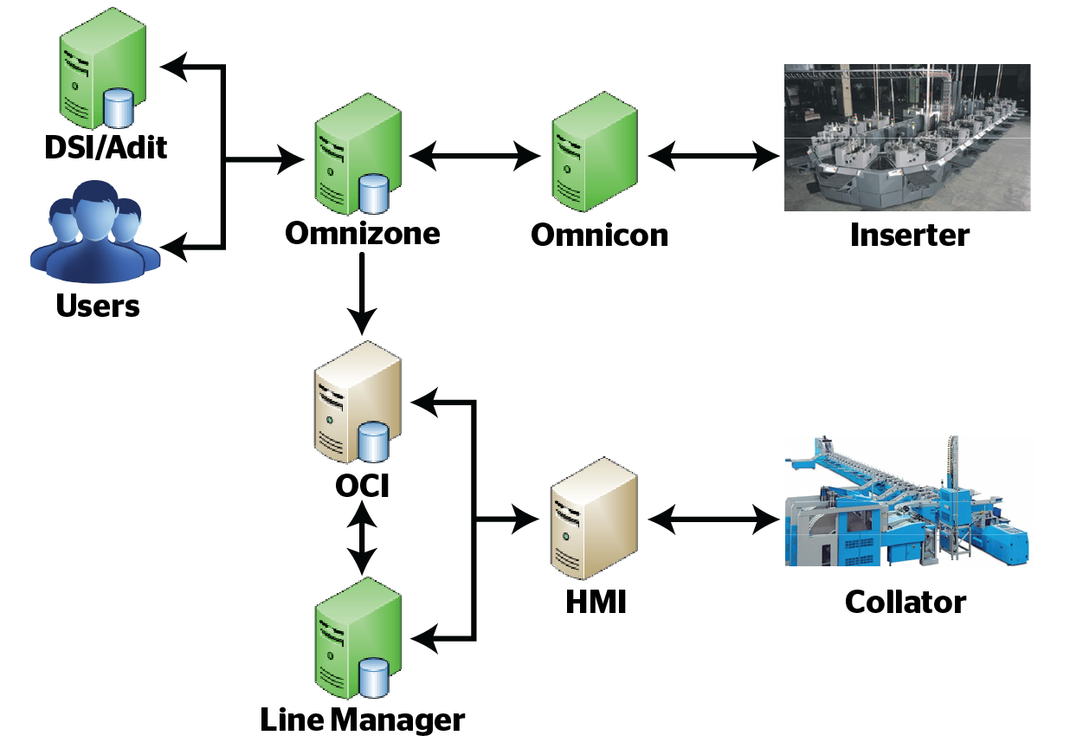
Packaging/Distribution for Chicago Tribune
OMNIZONE: Setup and monitoring sales order entry, package planning, production monitoring (misses, doubles, etc.), and truck distribution system.
OMNICOM –HMI: Applications that accept package planning data from planning system; controls inserting machines, providing production stats to the planning systems.
LINE MANAGER: Allows users to release orders to the collators as well as modify Hopper assignments.
OCI: Responsible for planning, managing, tracking and producing collated products.

Slide 9
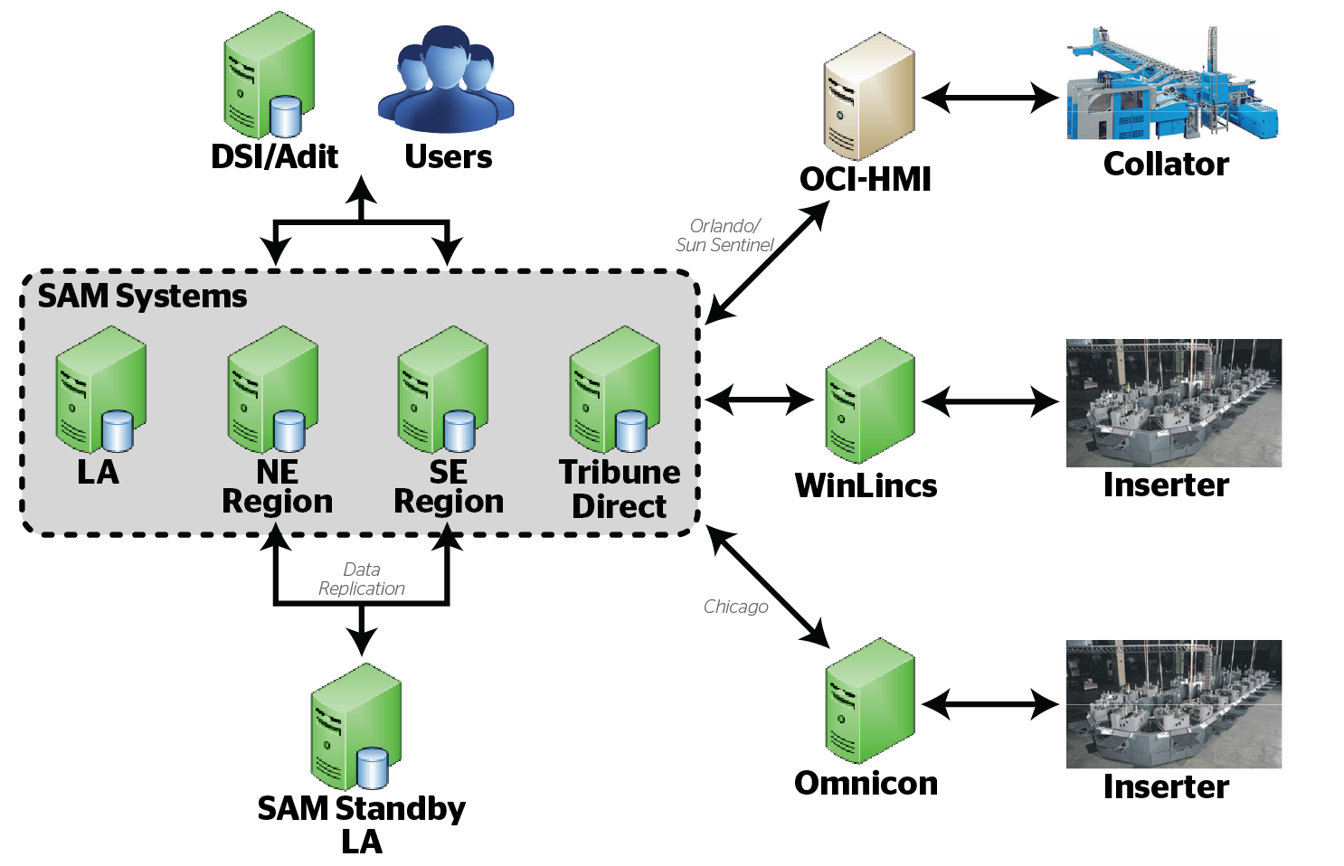
Packaging/Distribution Rest of tronc
SAM: Planning system that uses Circulation draw, sales order for preprint, and press products to build multi-product packages that are then scheduled and tracked to Inserts and Collators. Produced packages are managed and tracked for the truck distribution and postal delivery.
HMI-OMNICOM-WINLINCS: Applications that accept package planning data from planning system; controls inserting machines, providing production stats to the planning systems

Slide 10
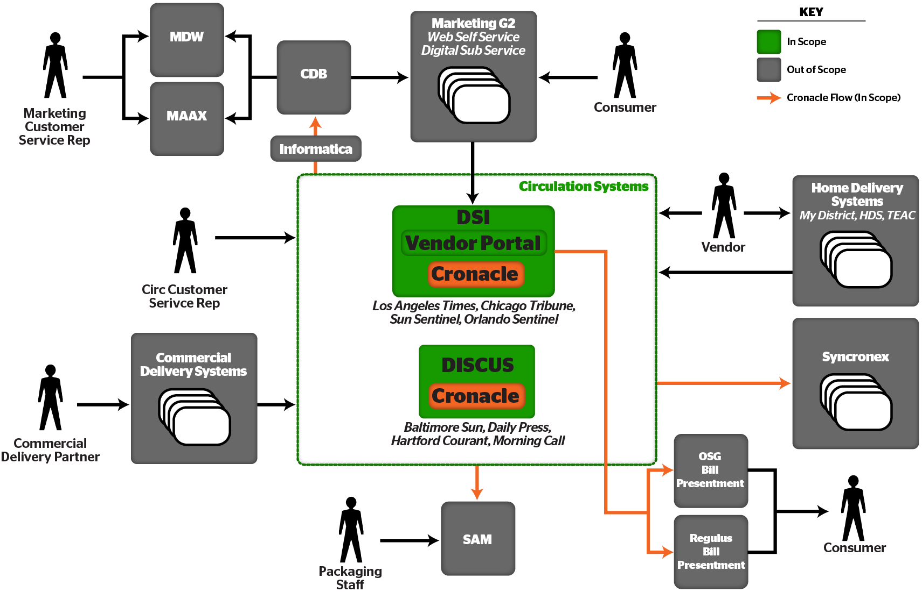
Circulation Systems Overview
DSI: Primary 24x7 Circulation tracking system. Runs out of the Chicago and LA data centers on Oracle DB environments with Citrix/Windows based front-end graphical user interfaces (GUI).
Cronacle: Advanced scheduling environment that controls all batch processing for DSI and all interfaces.
Notes:
Notes:
Need to simplify the diagram
Provide description of each In-scope system; and talk through each of the Out-of-scope systems.
List the markets that are on DSI and which are on DISCUS
Indicate that there is a detailed System Diagram in Appendix
Or include a separate page.
Connect arrows to boxes
Use image of one person-not grouping, to reduce the “weight” of the image
Define acronyms
Informatica appears to be floating outside of the chart
How does cronacle work with DISCUS and DSI – this should be visually represented
Make informatica gray
Remove blue boxes
DSI – LA Chi , Flordia 2x
DISCUS – balt, allentown, hartford, dpress
Synronex gray
Green=vendor solutions in scope
Blue=externally hosted solutions
Gray= internally hosted systems out of scope
Every arrow leaving center is run through cronacle

Slide 11
Appendix
Detailed System Diagrams

Slide 12
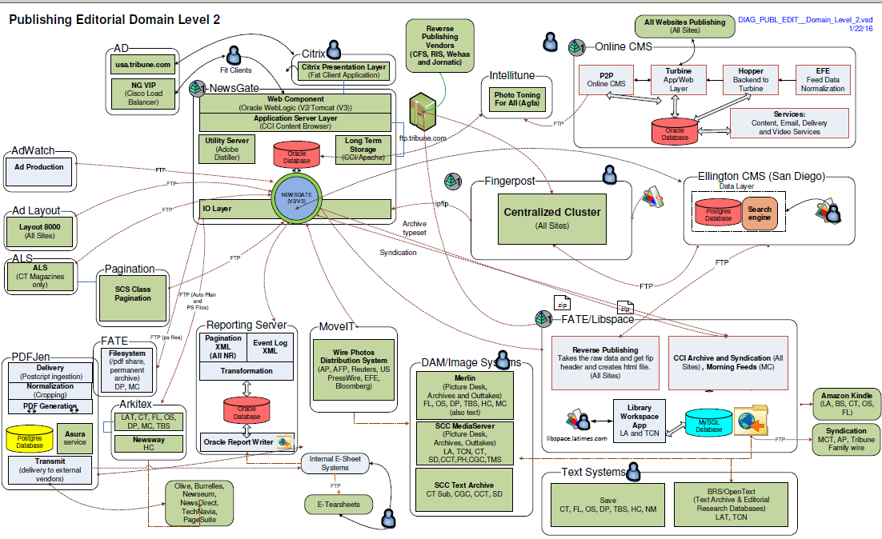
Business Process Overview – Editorial

Slide 13
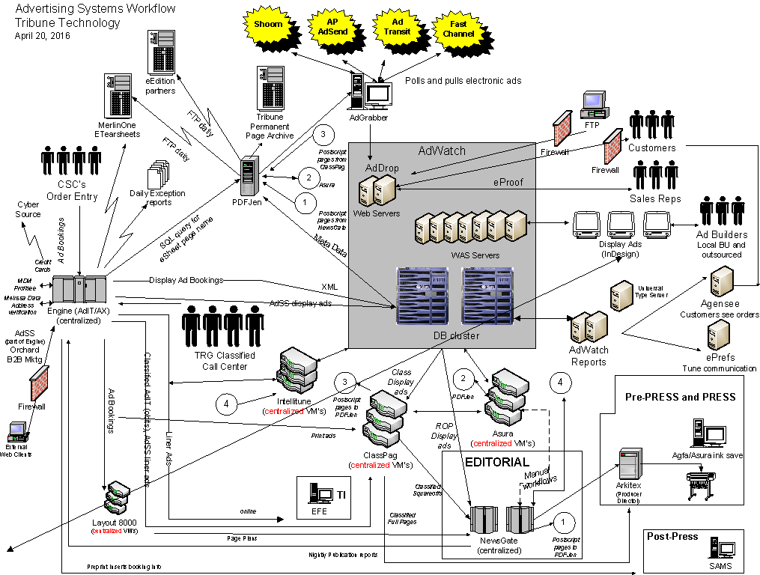

Slide 14
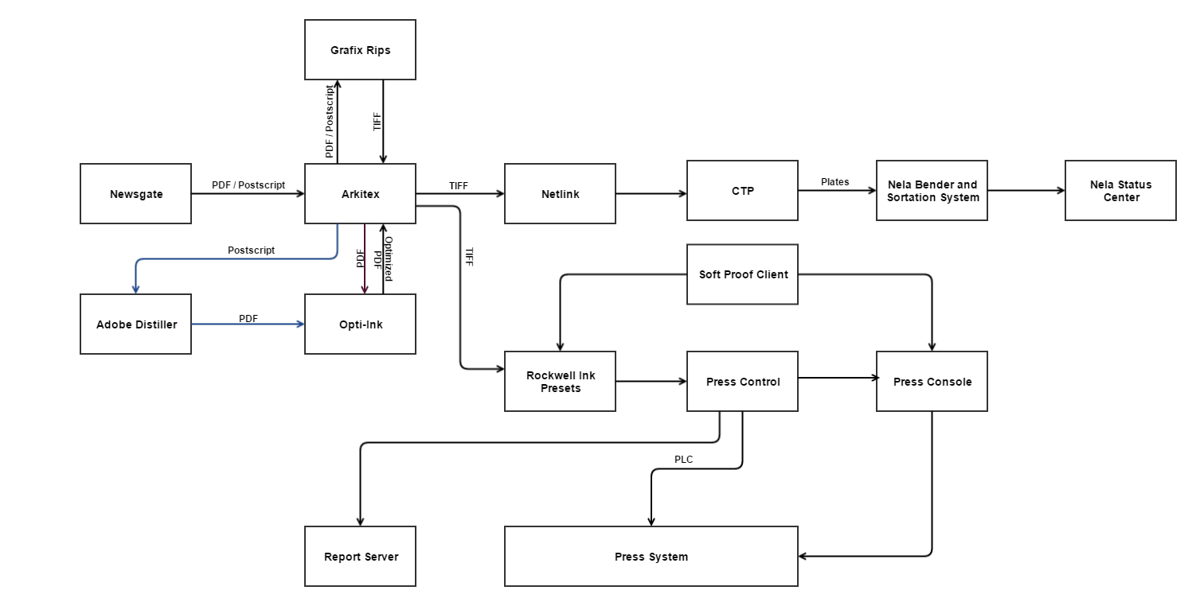
Typical Output Press Workflow(using Chicago as example)

Slide 15

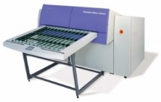
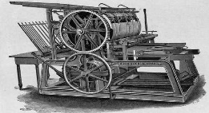

Typical Press Workflow
TIFF
PDF/POSTSCRIPT
CMY0
000K
CONVERTER
Opti-Ink
Newsgate
Arkitex
CMYK
Grafix Rips
Netlink
Newsdrive
COMPRESSION
PDF/
POSTSCRIPT
PDF/POSTSCRIPT
PDF
TIFF
TIFF
INK CALCULATION
Press
Control
Console
Press
Ink Preset
CTP
PLATE BENDING
PRESS
PLATE MOUNTING
BENDER AND SORTATION SYSTEM

Slide 16




LA Packaging and Distribution Workflow (All Other Sites except Chicago has the same except KPI Collector)
Circulation Tower
DSI
Inserters
Advertising Tower
AdiT
KPI Collector
SAM
IBM MQ
Winlincs
Success and Failure Stats
Interface between AdiT and SAM
Converts the data to a SAM compliant format
Windows Service
Part of Post Press operation
Build packages and Orders
Load packages and assign them to inserters
Used in all the regions except Chicago
Tech Stack
Oracle 9i
Power Builder
It exhibits 1:1 relationship with the Inserter machine
Determines package assignment to Hoppers
Job processing for Inserter
Status reporting through inserters
Users

Slide 17
Packaging and Distribution Workflow (Chicago)
Circulation Tower
DSI
Inserters
Advertising Tower
AdiT
Omnizone
PSI
Omnicom / HMI
Plan, create and Release production plans
Interact with Inserting and Printing machines
Quantity assignment
Creates Orders
Build, Load and assign packages to Inserters
User Role management
Gateway between Omnizone and HMI
Controls the inserter machine
Works with the PCPC Computers
Makes Hopper adjustment
Users

Slide 18
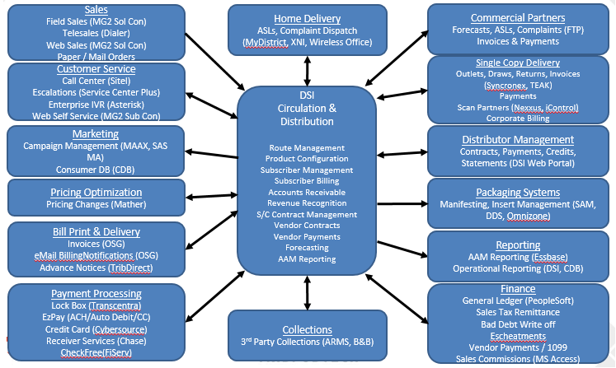
Circulation & Distribution Eco-System

Slide 19
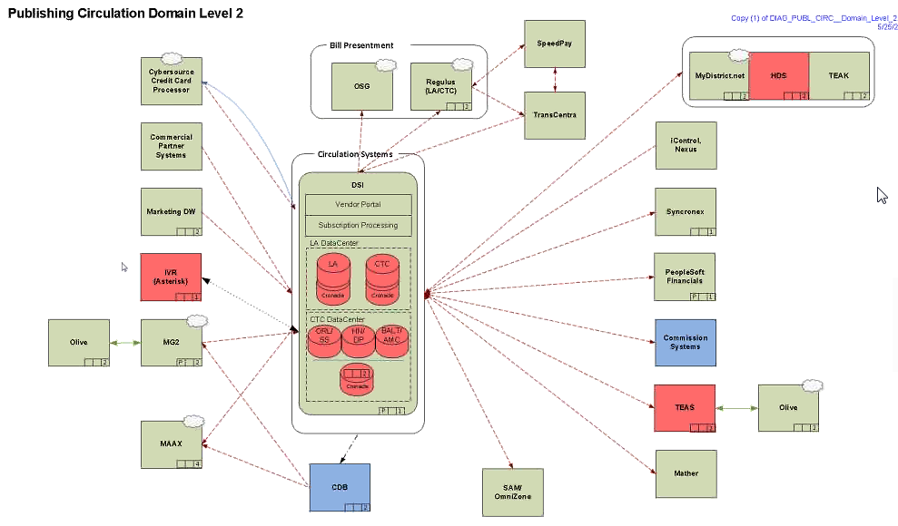
Architectural Overview

Slide 20
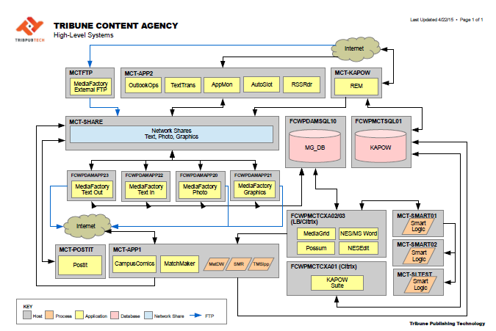
TCA – High Level System
Key Stakeholders, Roles and Responsibility

Slide 21
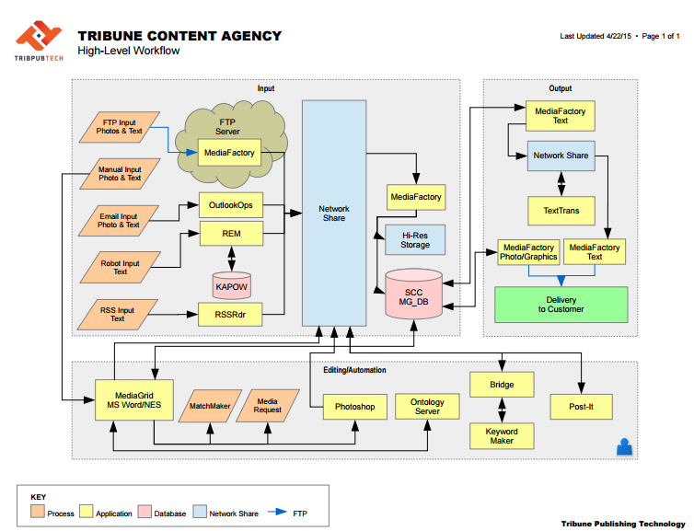
TCA – High Level Data Flow

Slide 22
Back Office (Finance ) Application Overview
Workday
BOA
EssBase
Blackline
Business Objects
PS Finance
[GL, AM ,AP , T&E ]
Engine
CCM
DIS
Cognos
Onbase

Slide 23
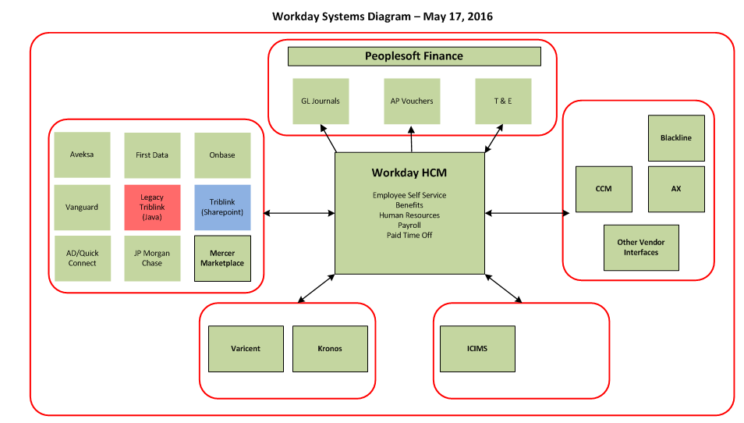
Back Office (HR) Application Overview

